Slide 1
Java WebDevelopment basis——FromServletToJSP
First03Chapter Building of Learning Environment and Related Introduction

Slide 2
learning target:
After studying in this chapter, you should:
Set up a development and operating environment
Grasp NetBeans IDE Basic usage
Familiar with NetBeans IDE Interface

Slide 3
3.1 Selection of development tools
Why you choose NetBeans IDE?
NetBeans IDE The configuration is simple, it can be used directly after installation, and there is no need to configure anything.
NetBeans IDE It's free and cost-effective.
In addition,Idea myEclipseIt are also common development tools for enterprises

Slide 4
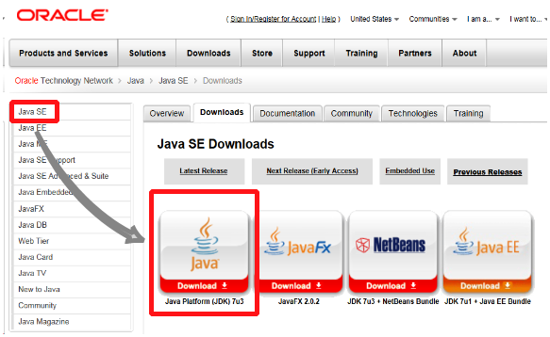
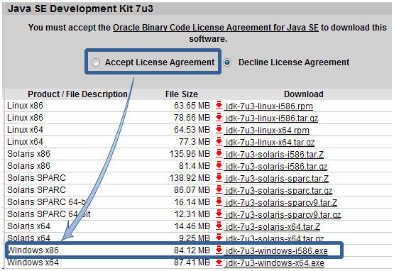
3.2 JDK with NetBeans IDE Download and installation
JDK Download and installation
Search in a search engineJDK, Select the official website in the search results, or visit the URL directlyhttp://www.oracle.com/technetwork/java/javase/downloads/index.htmlReachableJDKDownload page. On this page, click in the left navigationJava SEAnd selectDownloadsThe icon pointed by the arrow in the tab

Slide 5
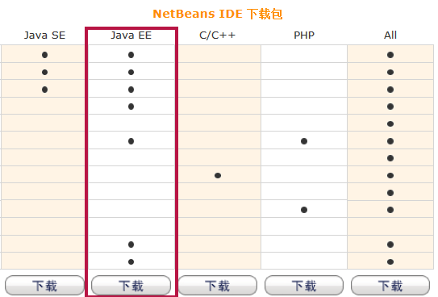
NetBeans IDEDownloads
Search in a search engineNetBeans IDE, Or visit this URL directlyhttp://netbeans.org/downloads/index.html, All reachableNetBeans IDEDownload page, select on this pageJava EEThe version (the part framed by the rectangular frame) can be downloaded,

Slide 6
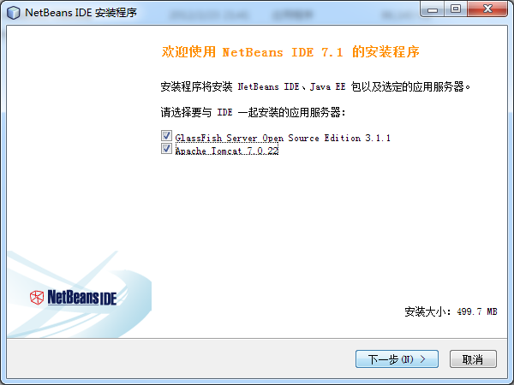
NetBeans IDE Installation (select application server)

Slide 7
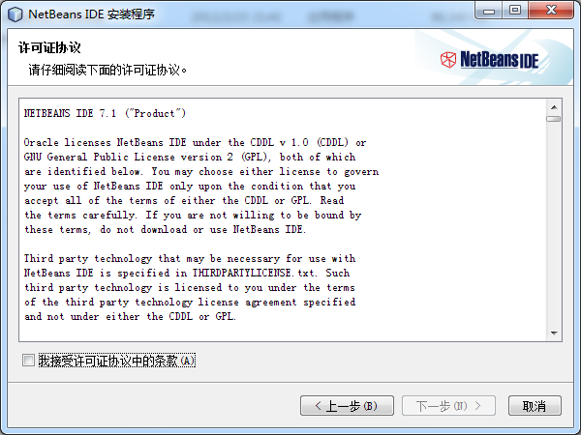
NetBeans IDEInstallation (accept the license agreement)

Slide 8
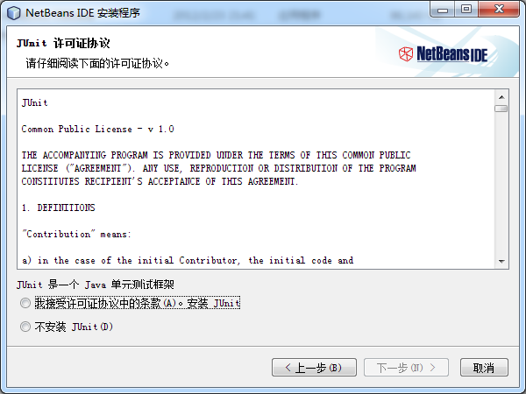
NetBeans IDEInstallation (whether to accept Junit License agreement)

Slide 9
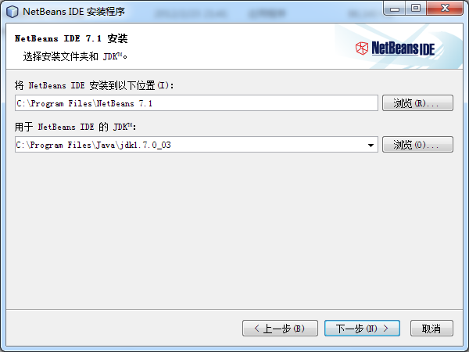
NetBeans IDEinstallation
(selectNetBeans IDEInstallation folder and usedJDK)

Slide 10
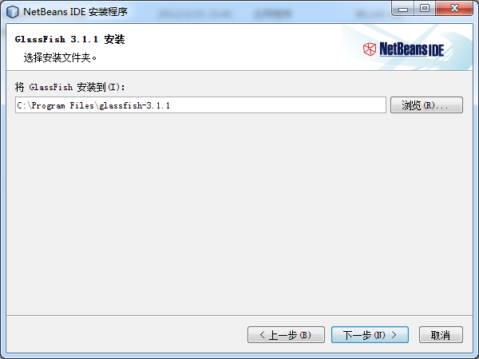
NetBeans IDEinstallation
(selectGlassFishInstallation folder)

Slide 11
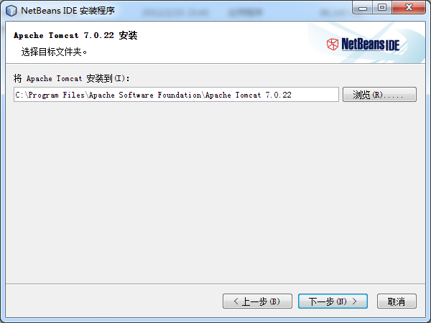
NetBeans IDEinstallation
(selectTomcatInstallation folder)

Slide 12
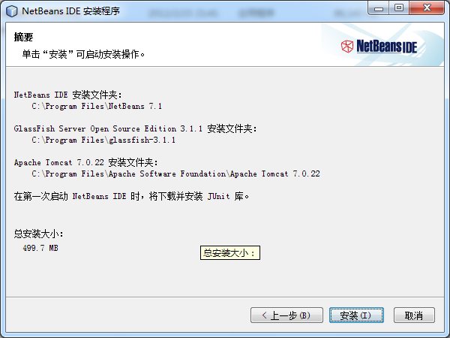
NetBeans IDEInstallation (installation summary prompt)

Slide 13
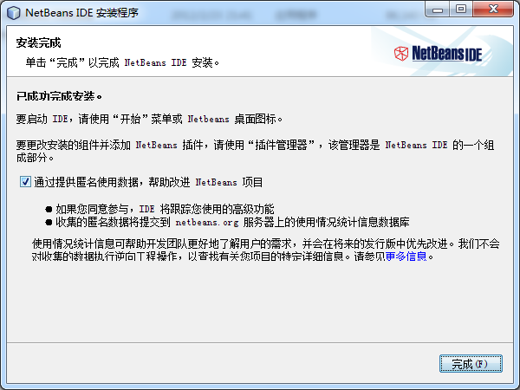
NetBeans IDEInstallation (installation complete)

Slide 14
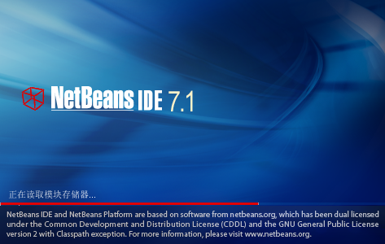
3.3 NetBeans IDEgetting Started
NetBeansStart interface

Slide 15
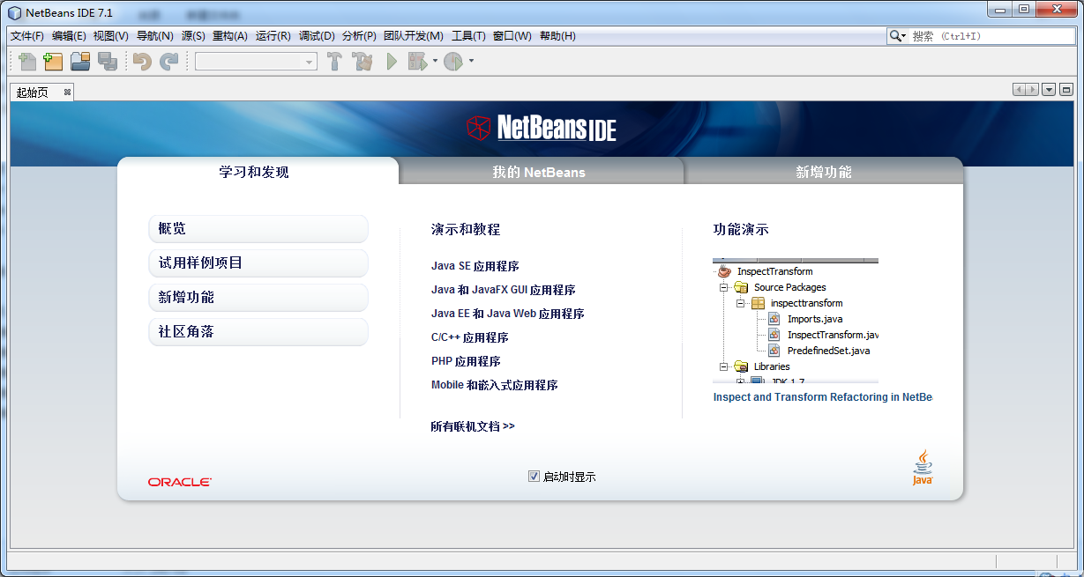
NetBeansWelcome Screen

Slide 16
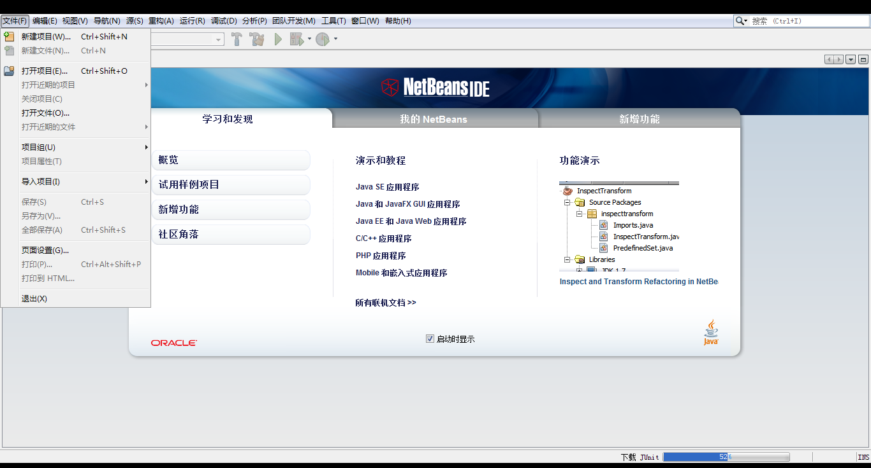
NetBeansNew project menu

Slide 17
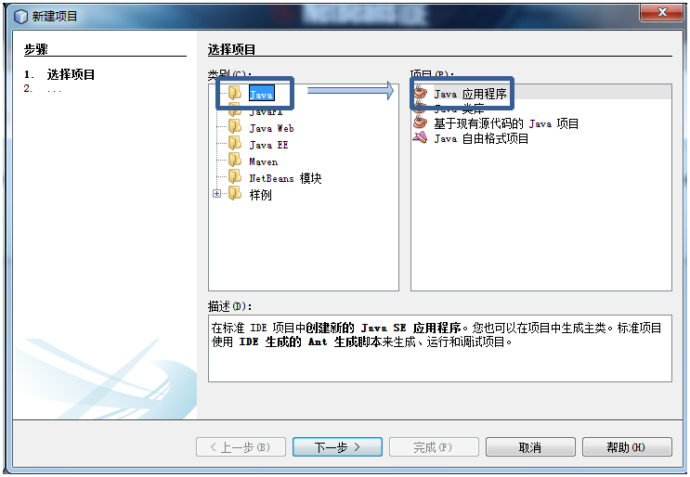
3.3.1 Use NetBeans IDE Develop console program
3.14 NewJavaapplication

Slide 18
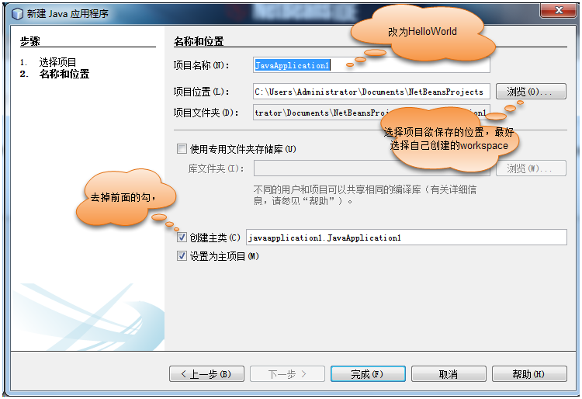
3.15 Set project name and storage location

Slide 19
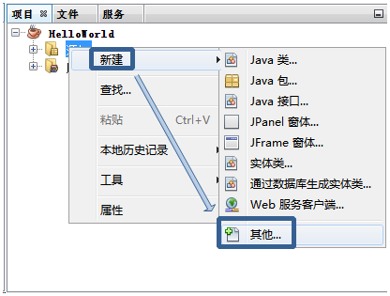
3.16 New other

Slide 20
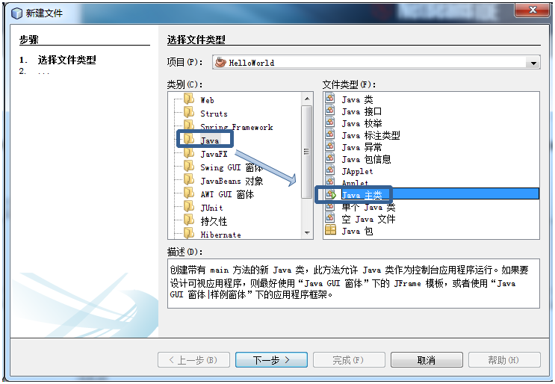
Figure3.17 NewJavaMain category

Slide 21
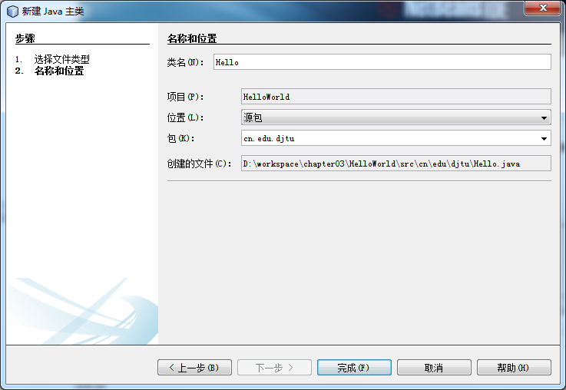
Figure3.18 Set the class name and package name

Slide 22
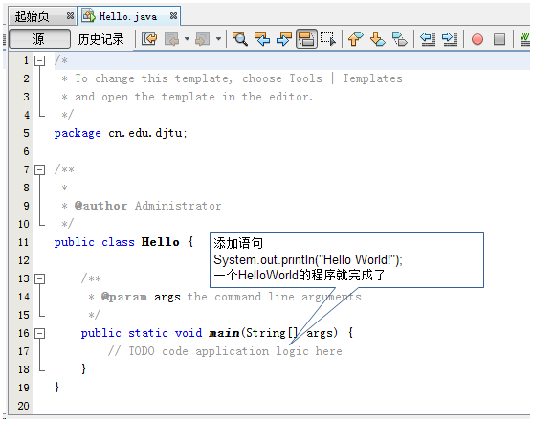
Figure3.19 Main categoryHelloProgram framework

Slide 23
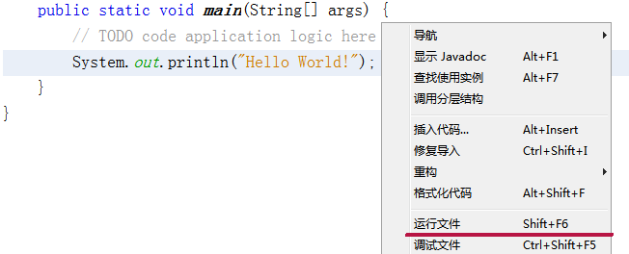
Right-click anywhere in the program source code and select"Run the file"Command to see the results of the program

Slide 24
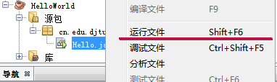
Can also be in"Source package"Select the file, right-click the mouse, and select from the pop-up menu"Run the file"Command, you can also see the results of the program

Slide 25
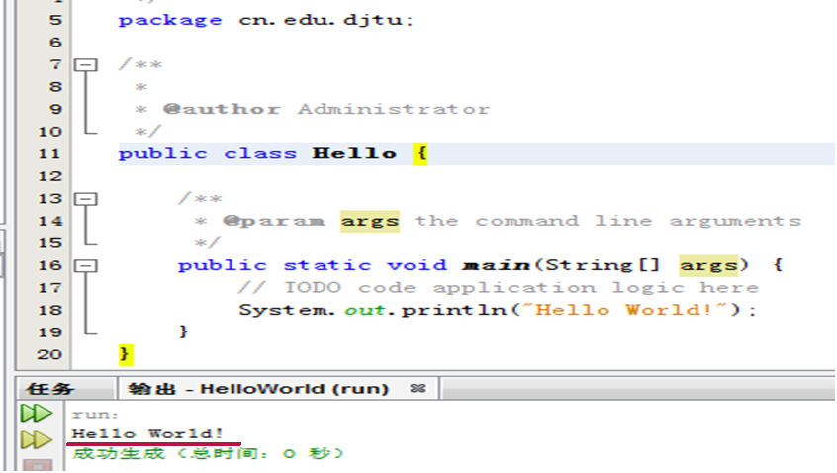
Figure3.20 Hello operation result

Slide 26
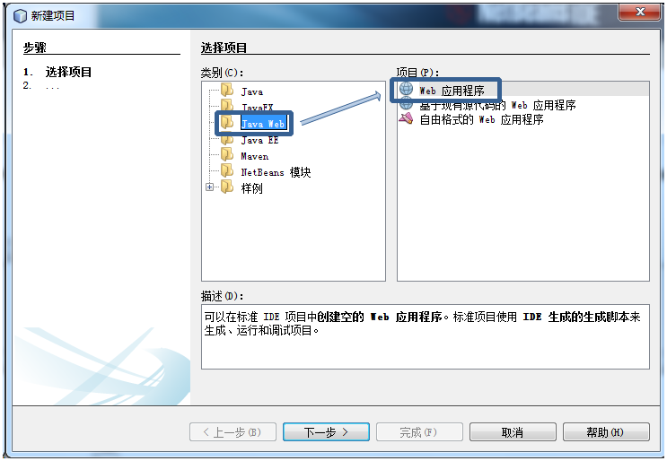
3.3.2 useNetBeans IDE Development WEB application
Figure3.21 NewJava Webapplication

Slide 27
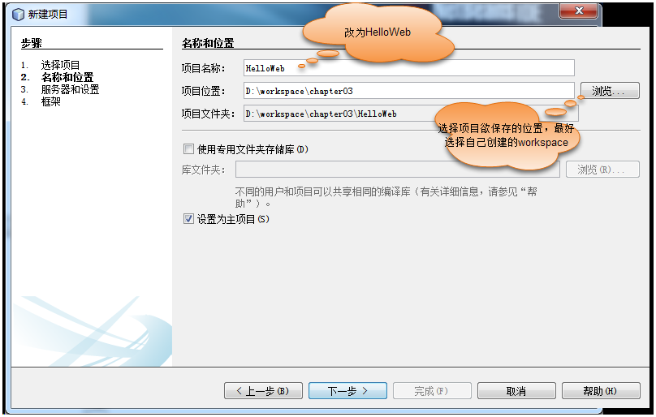
Figure3.22 Set the project name and storage location

Slide 28
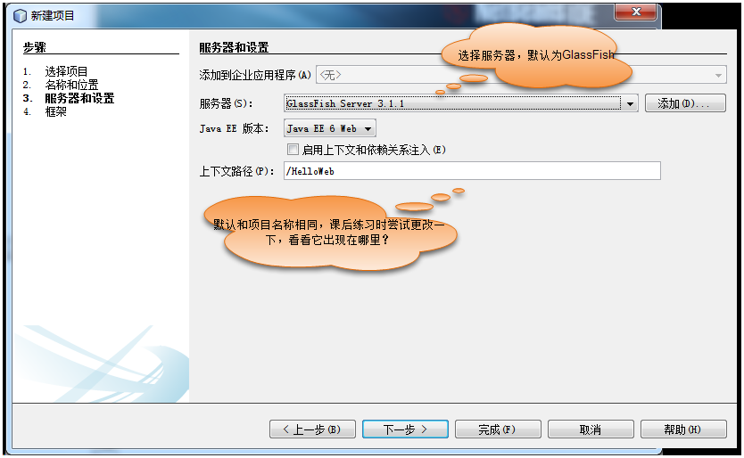
Figure3.23 Set server and context path

Slide 29
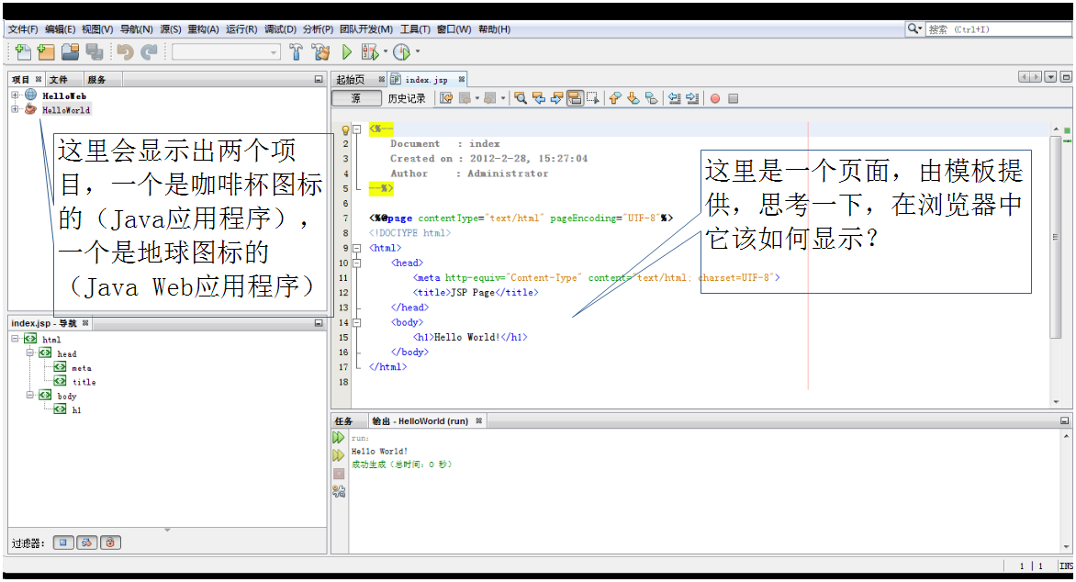
Figure3.24 HelloWebProject program framework——index.jspSource code

Slide 30
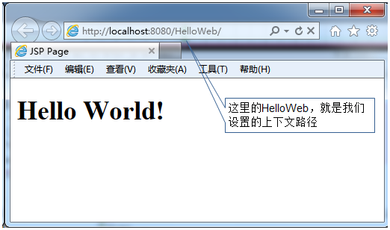
The operation mode is the same as the previous example
Figure3.25 HelloWebProject operation effect

Slide 31
Homework problems
[1].Download and install the appropriate version respectively JDK with NetBeans IDE.
[2].carry out HelloWorld project(Attention to create suitableworkspace).
[3].(Continuation)How to input quickly System.out.println("");?
[4].carry out HelloWebproject(Attention to create suitable workspace).
[5].(Continuation)Where is the context path displayed?

